Slide 1
Analytic Hierarchy Process (AHP)
TEACHING TEAM
DECISION SUPPORT SYSTEM COURSE
YEAR 2024/2025

Slide 2
What is AHP?
Analytic Hierarchy Process
The analysis technique is by arranging complex problems into levels called hierarchies.
The hierarchical elements in the AHP consist of:
1. Objective/Goal
2. Criteria (subcriteria are in it)
3. Alternatives

Slide 3
STAGES
1. Establishing a hierarchy of problems faced
Goal
Criteria 1
Criteria 2
Criteria 3
…………………………..
n-th Criteria
Alternative 1
Alternative 2
Alternative 3
…………………………..
m-th Alternative

Slide 4
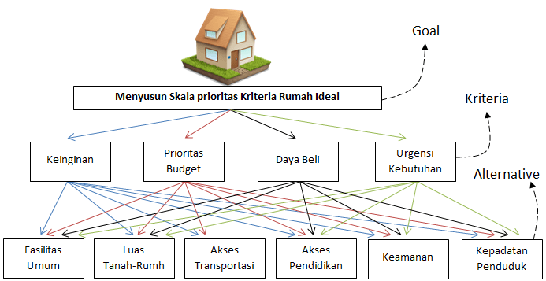
PERMATA JINGGA
SAWOJAJAR
GPA
SENGKALING INDAH
GADANG PERMAI

Slide 5
STAGES
2. Pair comparison
Comparisons are made in pairs between each criterion or each alternative
Intensity of Interest | Information
1 | Both elements are equally important
3 | One element is slightly more important than the other
5 | One element is more important than the other
7 | One element is clearly more absolutely important than the other
9 | One element is absolutely more important than the other
2,4,6,8 | Values between two adjacent considerations
(Saaty, 1986)

Slide 6
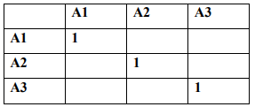
The pairing comparison process starts from the top level of the hierarchy which is aimed at choosing criteria, for example A1 is then taken the elements to be compared, namely: A1, A2, and A3.

Slide 7
PAIRWISE COMPARISON MATRIK (MATRIK PERBANDINGAN BERPASANGAN)
Example
Intensity of Interest | Information
1 | Both elements are equally important
3 | One element is slightly more important than the other
5 | One element is more important than the other
7 | One element is clearly more absolutely important than the other
9 | One element is absolutely more important than the other
2,4,6,8 | Values between two adjacent considerations
 | element
X | A | B | C
A | 1 | 3 | 5
B | 1/3 | 1 | 5/3
C | 1/5 | 3/5 | 1

Slide 8
STAGES
3. Priority Weight
Divide each cell value by the number of each column that corresponds.
Add and flatten each row.
The average shows the Priority Weight (PW) value for each row in question.

Slide 9
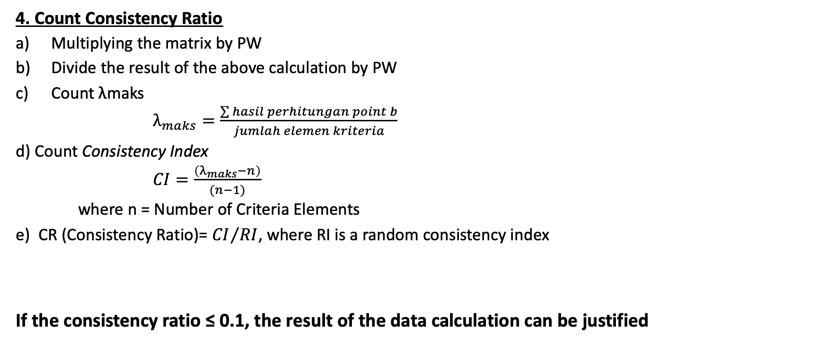
STAGES
4. Count Consistency Ratio
Multiplying the matrix by PW
Divide the result of the above calculation by PW
Count λmaks
$λ_{maks}=\frac{\sum{hasil perhitungan point b}}{jumlah elemen kriteria}$
d) Count Consistency Index
$CI=\frac{\left(λ_{maks}−n\right)}{(n−1)}$
where n = Number of Criteria Elements
e) CR (Consistency Ratio)= ${CI}/{RI}$, where RI is a random consistency index
If the consistency ratio ≤ 0.1, the result of the data calculation can be justified
n | 1 | 2 | 3 | 4 | 5 | 6 | 7 | 8 | 9 | 10
RI | 0,00 | 0,00 | 0,58 | 0,90 | 1,12 | 1,24 | 1,32 | 1,41 | 1,45 | 1,51

Slide 10
STAGES
Calculate the Paired comparison for each alternative on each criterion in the same way (steps 1-4)
Decision making
Decision-making is based on a comparison of the calculation of the multiplication of the PW criteria with the preferred alternative PW.

Slide 11
# Example of AHP Case Study
The case that will be worked on is the selection of distributors. The alternatives to be chosen are 3 distributors (Makmur Jaya, Anugerah, and Permata) with 3 criteria used as assessment parameters, namely network breadth, credibility, and payment system.

Slide 12
Settlement
1. Arrange a hierarchy of problems faced
Choosing a Distributor
Network Breadth
Credibility
Payment
Makmur Jaya
Anugerah
Permata

Slide 13
Settlement
2. Couple comparison matrix
Intensity of Interest | Information
1 | Both elements are equally important
3 | One element is slightly more important than the other
5 | One element is more important than the other
7 | One element is clearly more absolutely important than the other
9 | One element is absolutely more important than the other
2,4,6,8 | Values between two adjacent considerations
How to read: 5x network breadth is more important than the payout Or 5 to 1
Kriteria | K.Jaringan | Kredibilitas | Pembayaran
K.Jaringan Kredibilitas Pembayaran Jumlah | 1/1 3/1 1/5 4.2 | 1/3 1/1 1/6 1.5 | 5/1 6/1 1/1 12

Slide 14
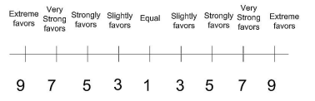









Settlement
Kriteria | K.Jaringan | Kredibilitas | Pembayaran
K.Jaringan Kredibilitas Pembayaran Jumlah | 1/1 3/1 1/5 4.2 | 1/3 1/1 1/6 1.5 | 5/1 6/1 1/1 12
2. Couple comparison matrix
Keluasan Jaringan
Kredibilitas
Kredibilitas
Pembayaran
$$√$$
$$√$$
Keluasan Jaringan
Pembayaran
Pembayaran
Keluasan Jaringan
$$√$$
$$√$$
Kredibilitas
Keluasan Jaringan
Pembayaran
Kredibilitas
$$√$$
$$√$$

Slide 15
Settlement
Kriteria | K.Jaringan | Kredibilitas | Pembayaran
K.Jaringan Kredibilitas Pembayaran Jumlah | 1/1 3/1 1/5 4.2 | 1/3 1/1 1/6 1.5 | 5/1 6/1 1/1 12
3. Calculating Priority Weights
Kriteria | K.Jaringan | Kredibilitas | Pembayaran
K.Jaringan Kredibilitas Pembayaran Jumlah | 1 3 0.2 4.2 | 0.333 1 0.167 1.5 | 5 6 1 12
Jumlah: kuantitas
Normalization 1 / 4.2 = 0.238
Eigen Vector
Kriteria | K.Jaringan | Kredibilitas | Pembayaran | Jumlah | Priority Weight
K.Jaringan Kredibilitas Pembayaran | 0.238 0.714 0.048 | 0.222 0.667 0.111 | 0.417 0.5 0.083 | 0.877 1.881 0.242 | 0.292 0.627 0.0081
PW KRITERIA

Slide 16
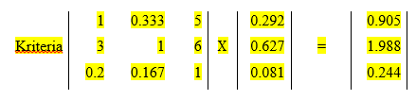

Settlement
Kriteria | K.Jaringan | Kredibilitas | Pembayaran
K.Jaringan Kredibilitas Pembayaran | 1 3 0.2 | 0.333 1 0.167 | 5 6 1
4. Calculating the Consistency Rasio (CR)
Multiplying the matrix by PW
b. Divide the result of the above calculation by PW
K.Jaringan = 0.905/0.292 = 3.095
Kredibilitas = 1.988/0.627 = 3.171
Pembayaran = 0.244/0.081 = 3.020
Matriks bobot kriteria
PW

Slide 17
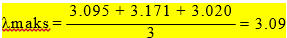
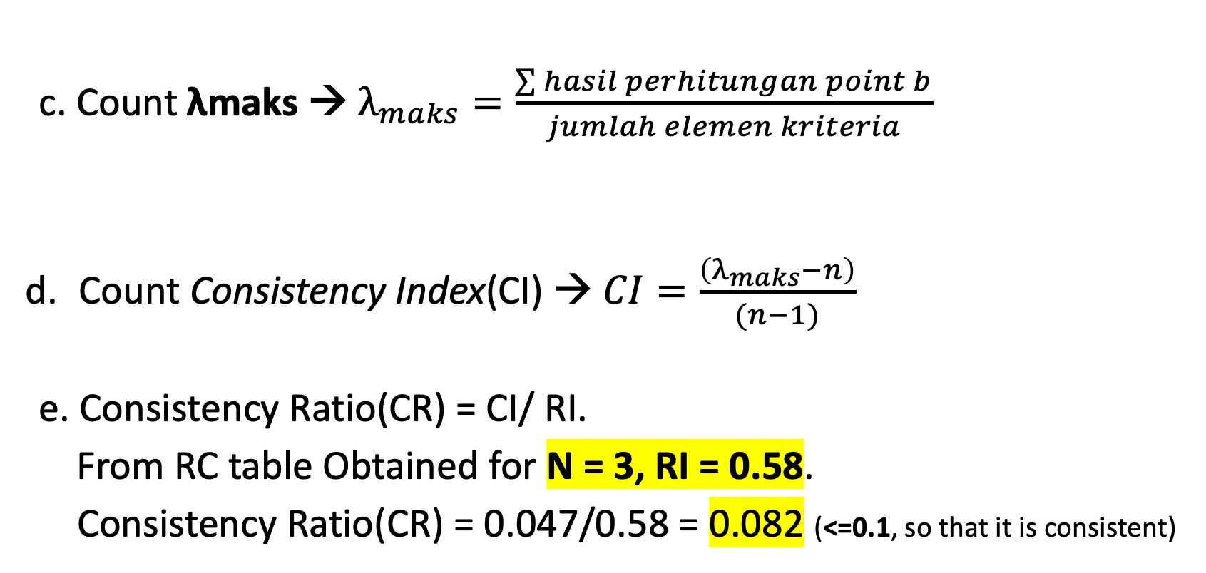
Settlement
c. Count λmaks → $λ_{maks}=\frac{\sum{hasil perhitungan point b}}{jumlah elemen kriteria}$
Count Consistency Index(CI) → $CI=\frac{\left(λ_{maks}−n\right)}{(n−1)}$
e. Consistency Ratio(CR) = CI/ RI.
From RC table Obtained for N = 3, RI = 0.58.
Consistency Ratio(CR) = 0.047/0.58 = 0.082 (<=0.1, so that it is consistent)
(3.09 − 3)
(3 − 1)
n | 1 | 2 | 3 | 4 | 5 | 6 | 7 | 8 | 9 | 10
RI | 0,00 | 0,00 | 0,58 | 0,90 | 1,12 | 1,24 | 1,32 | 1,41 | 1,45 | 1,51
CI₁ =
= 0.047

Slide 18
Settlement
5. Calculate the Paired comparison for alternatives
By the same calculation method, the Consistency Ratio (CR) is obtained for the pairwise comparison between the alternatives as follows:
a. Consistency Ratio(CR) kriteria Keluasan Jaringan
K.Jaringan | Makmur Jaya | Anugerah | Permata | Priority Weight | CR
Makmur Jaya | 1 | 5/1 | 7/1 | 0.724 | 0.057
Anugerah | 1/5 | 1 | 3/1 | 0.193
Permata | 1/7 | 1/3 | 1 | 0.083
Consistency Ratio(CR) = 0.057 (<=0.1, so that it is consistent)

Slide 19
SETTLEMENT
b. Consistency Ratio(CR) kriteria Kredibilitas
c. Consistency Ratio(CR) kriteria Pembayaran
Kredibilitas | Makmur Jaya | Anugerah | Permata | Priority Weight | CR
Makmur Jaya | 1 | 5 | 9 | 0.748 | 0.025
Anugerah | 0.2 | 1 | 3 | 0.180
Permata | 0.1111 | 0.333 | 1 | 0.071
Consistency Ratio(CR) = 0.025 (<=0.1, so that it is consistent)
Pembayaran | Makmur Jaya | Anugerah | Permata | Priority Weight | CR
Makmur Jaya | 1 | 5 | 7 | 0.724 | 0.038
Anugerah | 0.2 | 1 | 3 | 0.193
Permata | 0.142 | 0.333 | 1 | 0.083
Consistency Ratio(CR) = 0.038 (<=0.1, so that it is consistent)

Slide 20
SETTLEMENT
6. Decision Making
Decision making is based on a comparison of the calculation of the multiplication of the PW criteria with the preferred alternative PW
 | K. Jaringan | Kredibilitas | Pembayaran | Bobot Evaluasi
Bobot Prioritas | 0,292 | 0,627 | 0,081
Makmur Jaya | 0,724 | 0,748 | 0,724 | 0,739
Anugerah | 0,193 | 0,18 | 0,193 | 0,185
Permata | 0,083 | 0,071 | 0,083 | 0,075
Option number 1
Example calculation:
Bobot Evaluasi = (0.292 x 0.724) + (0.627 x 0.748) +(0.081 x 0.724)
= 0.739 (Makmur Jaya)

Slide 21
SETTLEMENT
Conclusion: From the results of the calculation above, it can be concluded that based on the criteria of network breadth, credibility, and payment, Makmur Jaya was selected as a distributor because it has the highest Evaluation Weight value of 0.739.

Slide 22
TUGAS
Kerjakan Jobsheet Pertemuan ke 3

